Slide 1

Mastering UI/UX Design: From Basics to Breakthroughs
Welcome to a practical guide for aspiring UI/UX designers and product teams. This presentation will provide actionable guidelines to elevate your design skills and create exceptional user experiences.

Slide 2


Chapter 1: The Foundations
Understanding UI & UX
UI (User Interface) and UX (User Experience) are two critical components of product design. While often used interchangeably, they represent distinct yet interconnected disciplines.
UI: The Look & Feel
UX: The Usability & Experience
The UI encompasses all visual elements users interact with: layouts, buttons, icons, colors, typography, and spacing. It's about how the product looks and is presented.
The UX focuses on the overall feel, ease of use, and satisfaction a user gains from interacting with the product. It's about how the product functions and the journey it provides.

Slide 3


Chapter 1: The Foundations
Why UI/UX Matters
Investing in good UI/UX is not just about aesthetics; it's a strategic imperative that directly impacts business success.
User Satisfaction
Increased Retention
Product Success
Intuitive and delightful experiences lead to happier users.
Users are more likely to return to a product that is easy to use.
Better UI/UX drives higher engagement, conversions, and market adoption.
"Design is not just what it looks like and feels like. Design is how it works." — Steve Jobs

Slide 4
Chapter 2: Crafting Visuals
Visual Design Best Practices
Effective visual design creates a seamless and appealing interaction, guiding the user effortlessly through the product.
Typography
Color Theory & Contrast
Use clear, legible fonts. Establish a strong typographic hierarchy using size, weight, and color to guide the user's eye and highlight key information.
Choose a harmonious palette. Ensure high contrast for readability, especially between text and background. Use color strategically for emphasis and to evoke emotion.
Icons & Imagery
Responsive Design
Maintain a consistent style for all icons and images. Ensure they support meaning rather than cluttering the interface. Opt for clear, recognizable visuals.
Design layouts that fluidly adapt to different screen sizes, orientations, and devices. Prioritize content and functionality to ensure a consistent experience across platforms.

Slide 5
Chapter 3: Core Principles
Principles of Good UI/UX Design
These foundational principles ensure that a product is not only aesthetically pleasing but also highly functional and user-centric.
1
Consistency
Maintain consistent design elements, interactions, and terminology across all screens and components to reduce cognitive load.
2
Clarity & Simplicity
Ensure navigation is straightforward and instructions are easy to understand. Minimize clutter and complexity.
3
Feedback
Provide immediate and clear feedback for user actions, such as loading indicators, success messages, or error alerts.
4
Familiarity
Utilize common patterns and intuitive interactions that users are already familiar with from other digital experiences.
5
Minimize Effort
Design pathways that require the least amount of user effort and cognitive load to complete tasks.

Slide 6
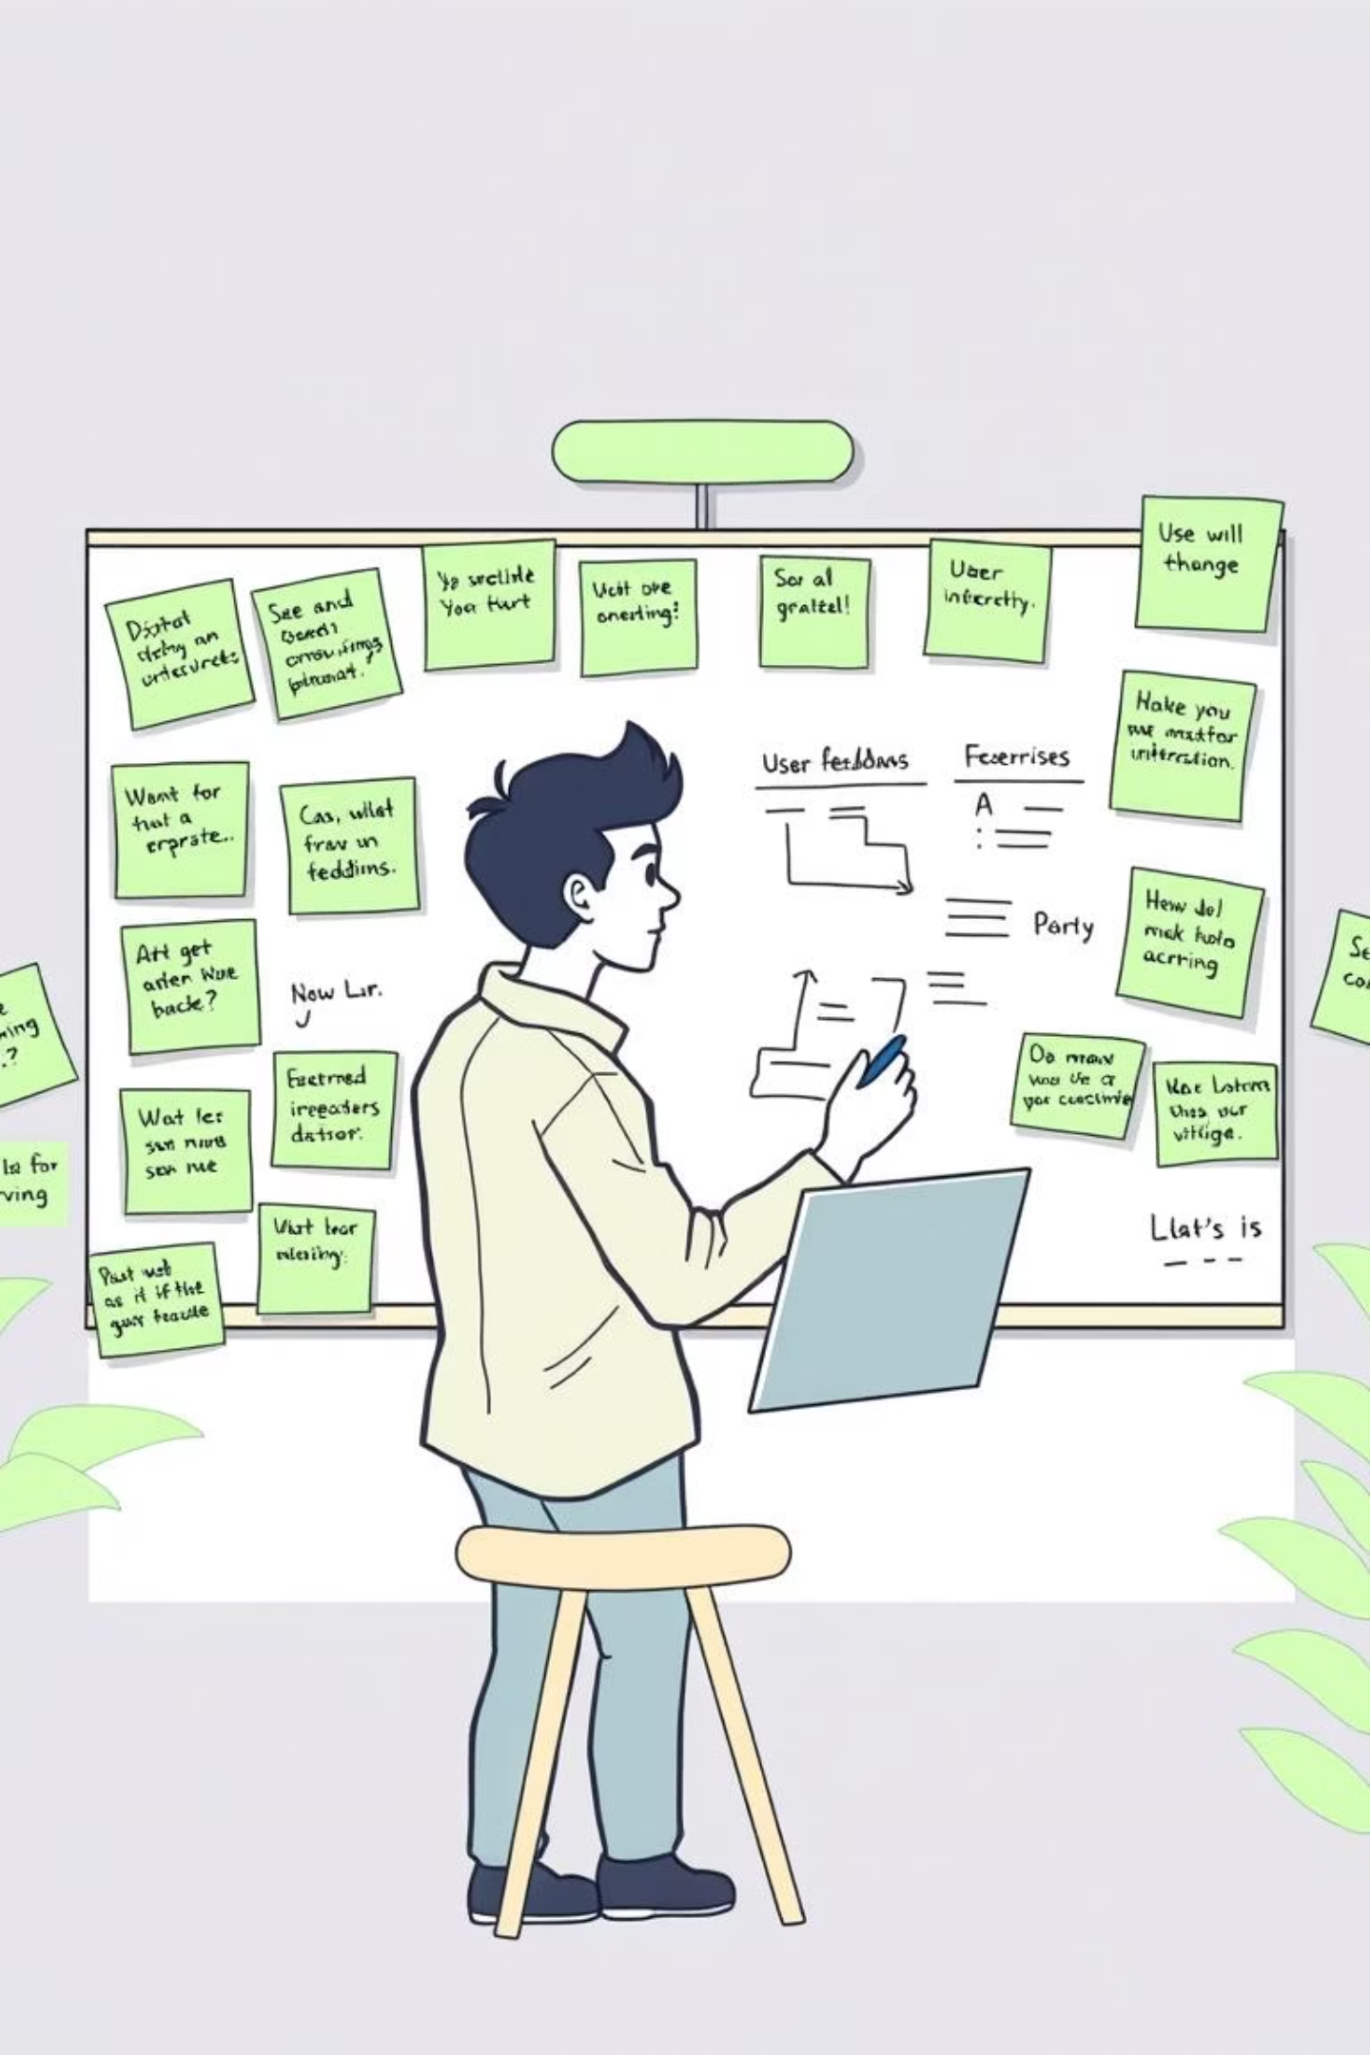
Chapter 4: Bringing it to Life
Interaction Design
Interaction design focuses on creating engaging and intuitive interfaces that respond effectively to user input.
Buttons: Use clear, concise labels and ensure prominent placement. Buttons should be appropriately sized for easy tapping or clicking across all devices.
Forms: Simplify fields to only essential information. Provide inline validation to guide users and offer clear instructions before they start typing.
Interactive Elements: Ensure all interactive elements, like toggles, sliders, or dropdowns, provide visual feedback (e.g., hover states, active states) to confirm user actions. Avoid hidden functionality.

Slide 7

Chapter 4: Bringing it to Life
Usability Testing
Usability testing is a non-negotiable step in the design process, revealing invaluable insights into how real users interact with your product.
Prototyping
Start with low-fidelity wireframes to quickly sketch layouts and flows. Gradually evolve to high-fidelity mockups that closely resemble the final product, allowing for early feedback and iteration.
User Testing
Observe real users performing specific tasks within your prototype. Pay close attention to their behaviors, pain points, and verbal feedback.
Iterative Improvement
Refine your designs based on the insights gained from user testing. This cyclical process ensures continuous improvement and a user-centered product.

Slide 8
Chapter 5: Design for All
Accessibility & Inclusive Design
Designing for accessibility ensures that your product is usable by people with diverse abilities, fostering a truly inclusive experience.
1
WCAG Guidelines
Adhere to Web Content Accessibility Guidelines (WCAG) to ensure your digital content is accessible to a broader audience.
2
Keyboard Navigation
Ensure all interactive elements and controls can be fully operated using only a keyboard, vital for users who cannot use a mouse.
3
Alt Text & Links
Provide descriptive alt text for all images and use meaningful link labels to aid screen readers and improve navigation.
4
Color & Contrast
Consider users with color blindness by avoiding reliance solely on color for information. Ensure sufficient contrast ratios for text and interactive elements.
5
Clear Language
Use simple, straightforward language and scalable fonts to improve comprehension for all users, including those with cognitive disabilities.

Slide 9






Chapter 6: The Evolving Landscape
Current Trends in UI/UX
The UI/UX landscape is dynamic, constantly evolving with new technologies and user expectations. Staying current is key.
Dark Mode & Themes
Micro-interactions
Offers visual comfort and extends battery life, often paired with customizable interface themes.
Subtle animations and visual cues that enhance user feedback and delight.
Voice UIs (VUIs)
Minimalist Layouts
Designing conversational interfaces for voice assistants and smart devices.
Focus on content, reducing visual clutter for a cleaner, more immersive experience.
Personalization
Ethical Design
Tailoring user experiences based on individual behavior and preferences.
Prioritizing user well-being, privacy, and fairness in design decisions.

Slide 10




Key Takeaways & Next Steps
Mastering UI/UX is an ongoing journey of learning and iteration. By applying these principles, you'll be well-equipped to create impactful and user-centric digital products.
Embrace User-Centricity
Iterate Relentlessly
Stay Curious
Always put the user at the heart of your design process.
Design is never "done." Continuously test, gather feedback, and refine.
Keep up with new trends, technologies, and evolving user behaviors.
Ready to design amazing experiences?
Start applying these insights to your next project!

